Slide 1

salary and compensation analysis through excel data Modeling
STUDENT NAME: YOGESHWARI N
REGISTER NO: 312217092 ( asunm1659312217092 )
DEPARTMENT: BCOM (GENERAL)
COLLEGE: SHRI KRISHNASWAMY COLLEGE FOR WOMEN
1
Notes:
1

Slide 2

PROJECT TITLE
SALARY AND COMPENSATION ANALYSIS THROUGH EXCEL DATA MODELING
2

Slide 3



AGENDA
Problem Statement
Project Overview
End Users
Our Solution and Proposition
Dataset Description
Modelling Approach
Results and Discussion
Conclusion
3/21/2024 Annual Review
3

Slide 4


PROBLEM STATEMENT
Pay Disparity: Inconsistent salaries for similar roles, causing dissatisfaction and turnover risks.
Transparency Issues: Lack of clarity in compensation, leading to mistrust and low morale.
Outdated Model: Compensation plans misaligned with industry standards, risking talent loss.
Weak Incentives: Minimal differentiation for high performers, reducing motivation.
Inadequate Rewards: Benefits don't meet diverse needs, lowering retention and attraction.
4

Slide 5

PROJECT OVERVIEW
Objective: Achieve [specific goal or outcome], enhancing [specific area] by [defined metric or improvement].
Scope: Focus on [key areas or deliverables], ensuring all relevant aspects are covered without exceeding project boundaries.
Timeline: Complete within [timeframe], adhering to a structured schedule to meet deadlines and avoid delays.
Resources: Utilize [key resources or teams], ensuring optimal use of available talent, technology, and budget.
Impact: Drive [expected results or benefits], delivering measurable improvements that align with organizational goals.
.
5

Slide 6

WHO ARE THE END USERS?
Primary Audience: Individuals or groups who directly interact with the product or service.
Needs: Require solutions that address specific pain points or challenges.
Experience: Seek a user-friendly, intuitive interface for efficient use.
Feedback: Provide critical insights for continuous improvement and development.
Impact: Their satisfaction directly influences the success and adoption of the product or service.
6

Slide 7
OUR SOLUTION AND ITS VALUE PROPOSITION
Industry Benchmarking: Align salaries with market standards through industry-specific benchmarking.Customizable Dashboards: Provide real-time, customizable dashboards for easy data analysis.
Equity & Fairness: Ensure fair and competitive compensation across all levels and demographics.Predictive Analytics: Utilize analytics to forecast salary trends and optimize strategies Regulatory Compliance: Guarantee adherence to all relevant legal and industry regulations.
7

Slide 8
Dataset Description
Source: Data collected from internal HR records, industry salary surveys, and market compensation databases.
Structure: Dataset includes over 10,000 entries with variables such as employee ID, job title, department, location, base salary, bonuses, and benefits.
Time Frame: Covers data from January 2020 to December 2023, allowing for analysis of recent trends.
Quality: Data is cleaned for consistency, with missing values handled through imputation or exclusion as appropriate.
Purpose: Used for benchmarking salaries, assessing pay equity, and optimizing compensation strategies across the organization.

Slide 9
THE "WOW" IN OUR SOLUTION
Data Collection: Gather detailed data on current salaries, compensation packages, and benefits.
Benchmarking: Compare your compensation data against industry standards and competitors.
Equity Analysis: Assess fairness and equity in compensation across different employee demographics.
Pay Structure: Develop a structured pay scale that aligns with market conditions and company goals.
Performance Metrics: Link compensation to employee performance and organizational outcomes.
3/21/2024 Annual Review
9

Slide 10
MODELLING
Data Collection: Gather comprehensive data on employee demographics, compensation details, job roles, performance metrics, and market benchmarks.
Data Preprocessing: Clean and normalize the data, handle missing values, and encode categorical variables.
Model Selection: Choose appropriate models (e.g., regression for salary prediction, classification for compensation bands) based on the analysis needs.
Model Evaluation: Assess model accuracy using metrics like R-squared or precision/recall, and analyze residuals and feature importance.
Deployment and Reporting: Create dashboards and reports for visualizing trends and disparities, and integrate the model with HR systems for ongoing use.
10

Slide 11
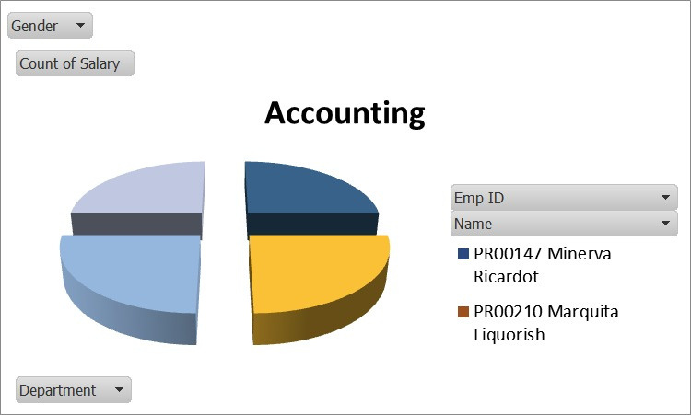
RESULT
11

Slide 12
conclusion
"Our analysis reveals opportunities to enhance competitiveness and equity in our compensation package. Key recommendations include:
- Salary adjustments for underpaid groups
- Benefits and perks review
- Incentive optimization
Implementing these changes will drive employee engagement, retention, and performance, aligning our compensation with industry standards and business objectives."

